Slide 1
GitHub Tutorial
Koko Friansa

Slide 2

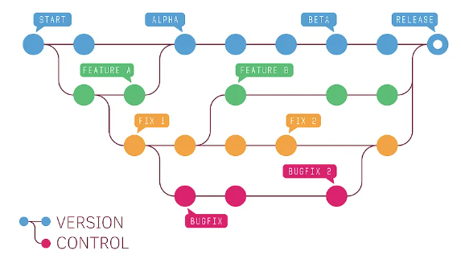
What is GitHub
Definition:
GitHub is a cloud-based platform for version control and collaborative software development.

Slide 3
Key Feature
Repository Hosting: Allows users to create and store code repositories online.
Collaboration Tools: Supports team collaboration like pull requests, code reviews, and issue tracking.
Documentation: Users can create or upload a files: README files (README.md),
Community Contributions: Facilitates open-source projects where developers can contribute and collaborate globally.
Integrations: Connects with various third-party tools and services, testing, and deployment.

Slide 4
Benefit

Slide 5
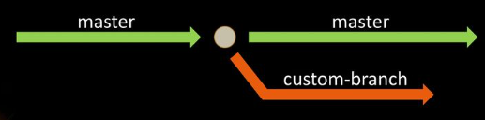
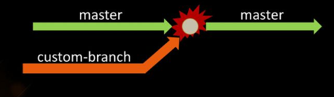
Branch and Merge
Branch Merge
Parallel Development: Branches allow working on different features simultaneously.
Isolated Changes: Keeps changes separate from the main/master code.
Combine Branches: Merge integrates changes from different branches.
Update Main/Master Code: Applies branch changes to the main project.

Slide 6
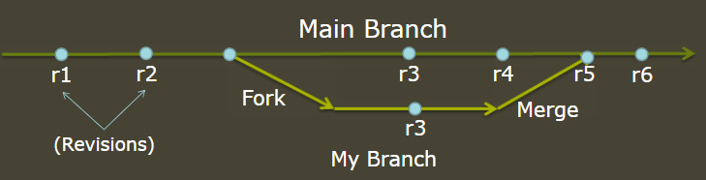
Forking Project
Create Personal Copy: Forking makes a personal copy of a project.
Experiment Freely: Allows independent changes without impacting the original

Slide 7
Branch and Fork
Branch
Fork
Internal development: Creates a parallel version of a project within the same repository (often for feature development or testing).
Feature development: bug fixes, or testing. Once the work is completed, the branch is typically merged back into the main branch.
Someone else’s project: Creates an independent copy of a repository (often for external contributions).
No Immediate Connection: Changes made in your fork do not affect the original repository until a pull request is accepted and merged.

Slide 8
How to Signup

Slide 9
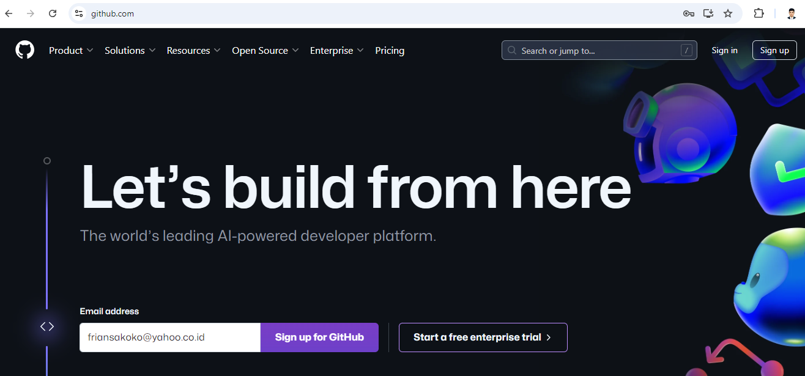
Get Started
https://github.com/

Slide 10
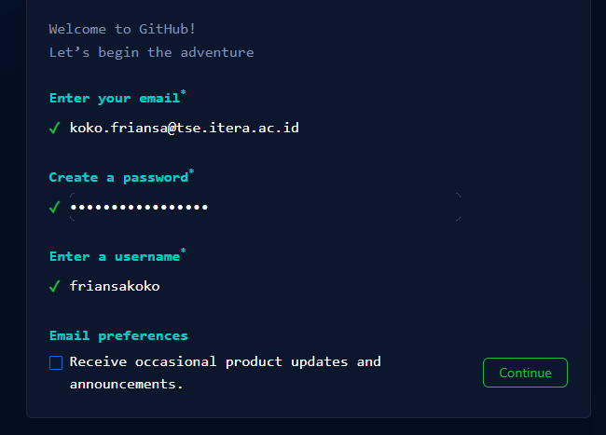
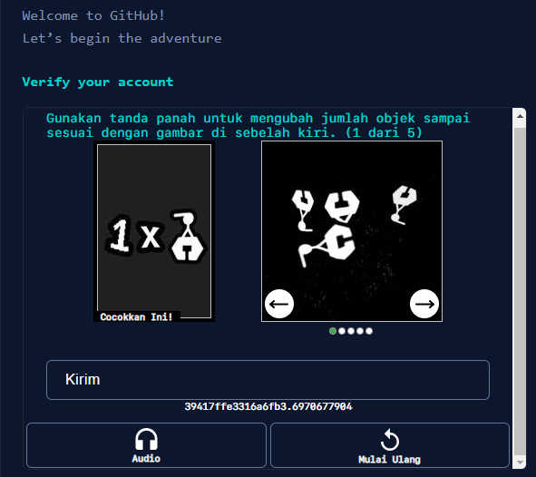
Signup Process
Create a username and password
CAPTCHA

Slide 11
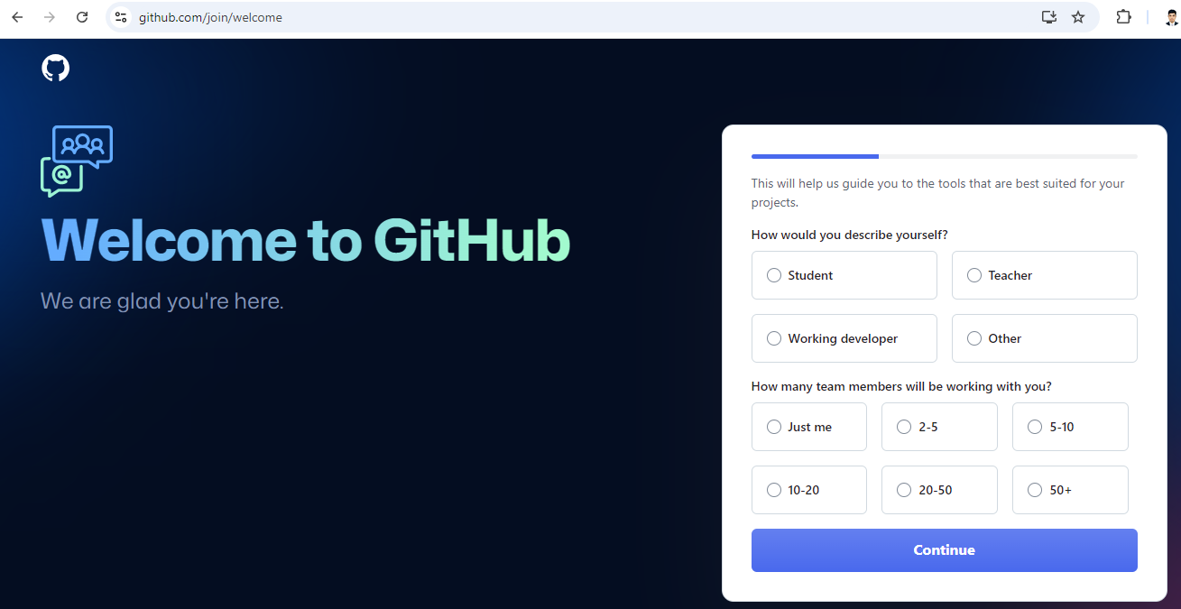
Describe yourself!

Slide 12
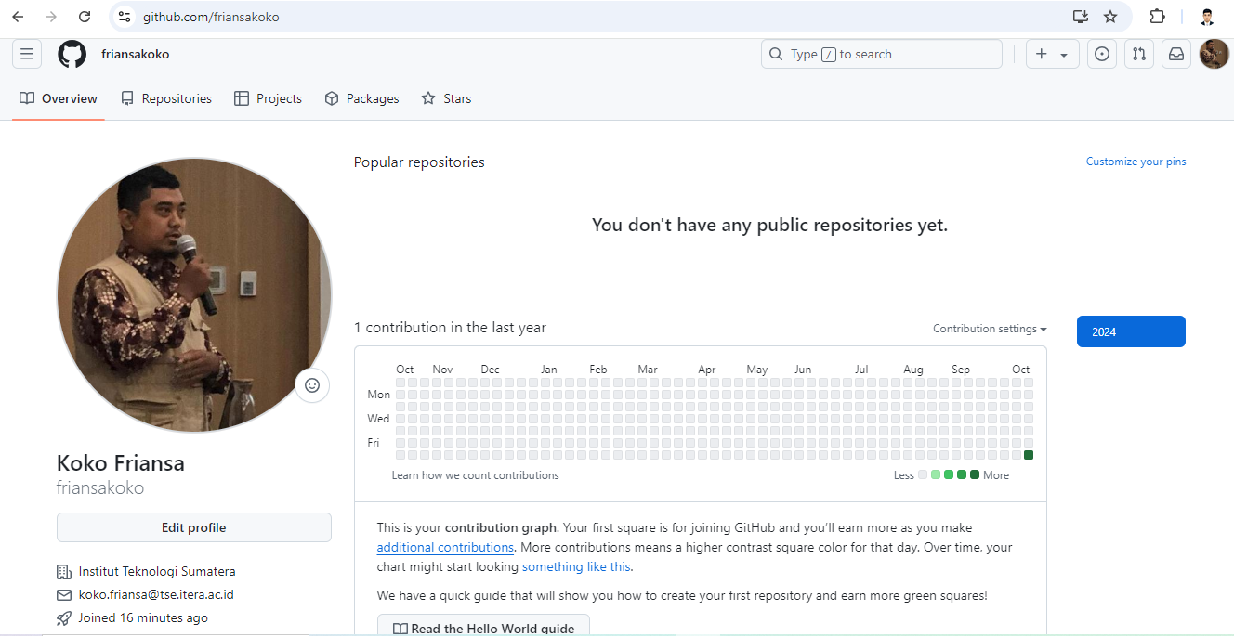
Edit your profile!

Slide 13
Submit your work

Slide 14
Submit your work
Create repositories
Upload file

Slide 15
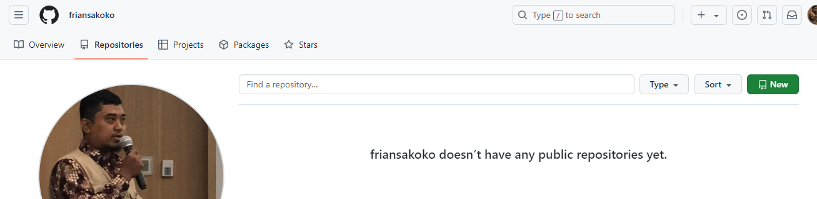
Create your repositories
Create repositories
Click Repositories Menu
Add New button

Slide 16
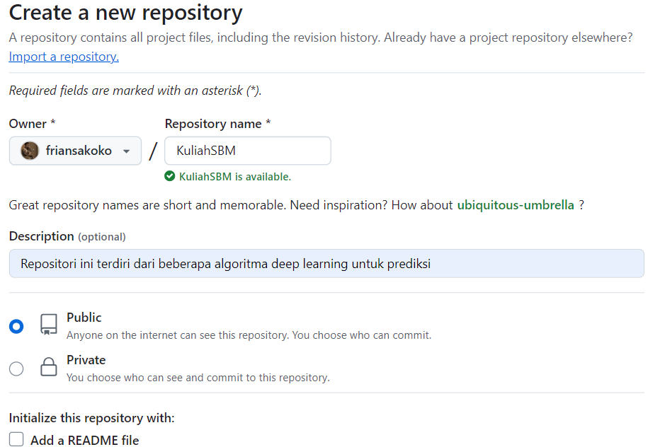
Create repositories
Write the repository name in the box
Description of the repository
A file that provides essential information about the project

Slide 17
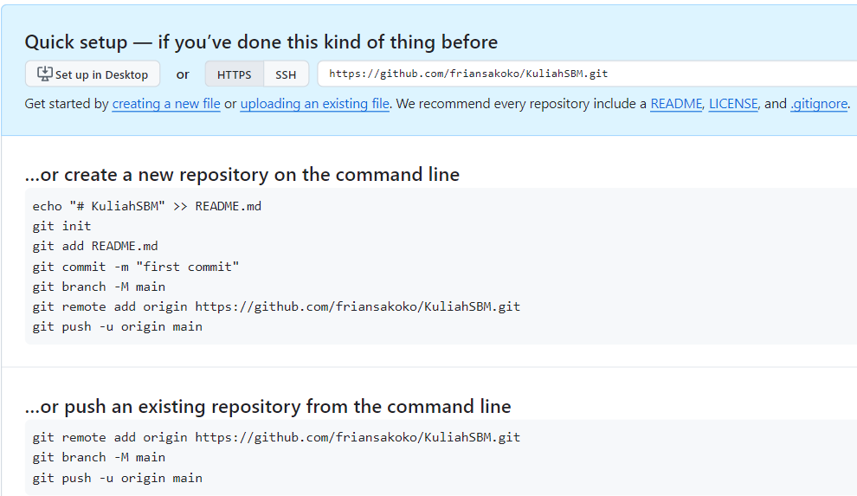
Interact with the repository
Create repositories
methods for securely communicating with a repository, specifically for operations like cloning, pushing, and pulling code.
Upload a file
Guide users on how to set up and push their code to the new repository.

Slide 18
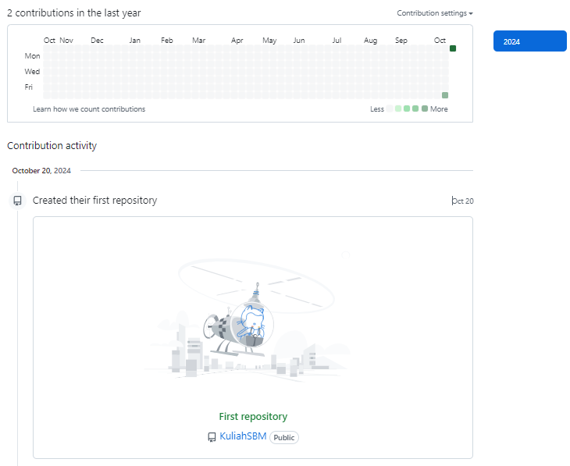
Congratulation!
Create repositories
A new activity has appeared.
A new activity (Create the first repository)

Slide 19
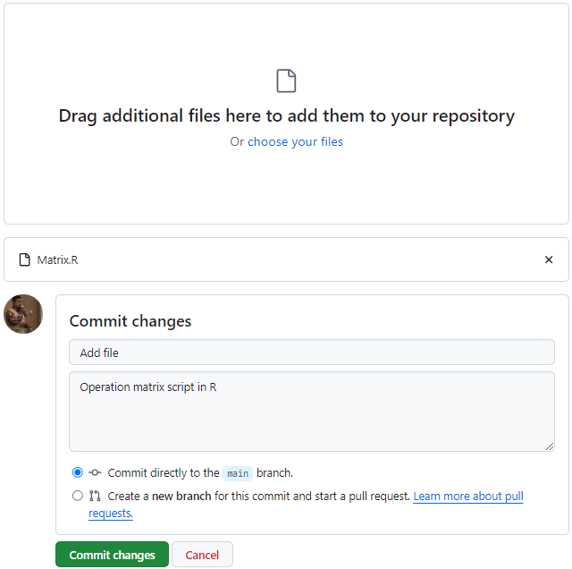
Upload File
Upload file
Drag and drop a new file
Candidate files to be uploaded
Commit box
(write a description for tracking, history management)
Click Commit changes button for uploading file

Slide 20
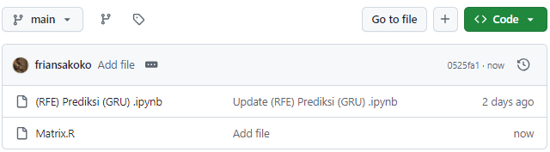
Congratulation!
Upload file
A new file has been uploaded

Slide 21
Update your work

Slide 22
Update your work
Commit
Branch
Merge

Slide 23
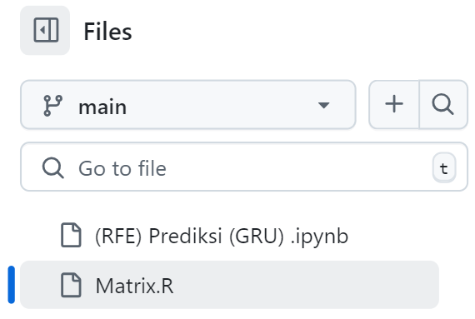
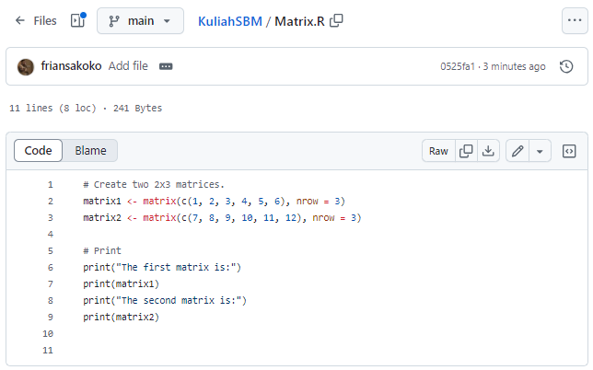
View file content
Commit
Preview file content
Click your main document
Contents in the main document

Slide 24

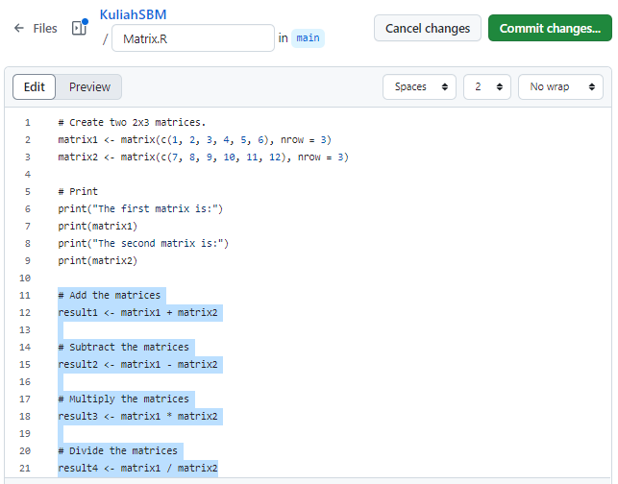
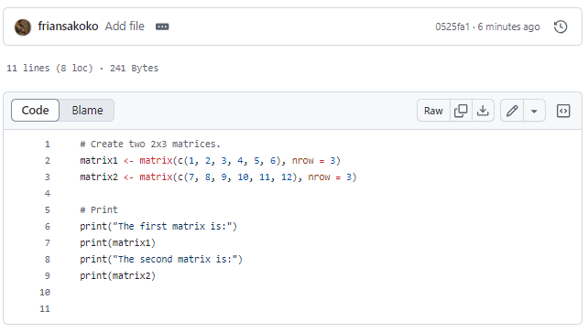
A new commit
Commit
Click Commit changes button after update the code
Code feature to preview or edit the code
Click button for editing the code
Update code

Slide 25
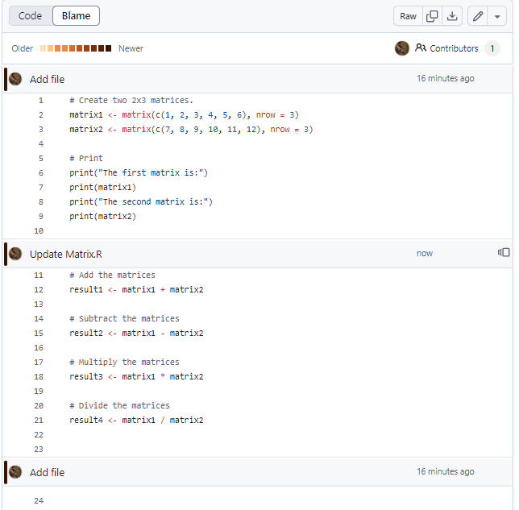
A new commit
Commit
Blame is a feature that helps track who made specific changes to a file and when those changes were made
A new commit ‘Update Matrix’

Slide 26
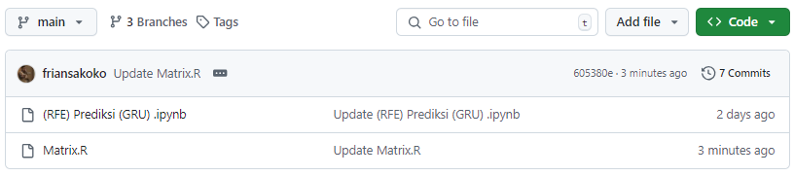
A new branch
Branch
Click Branches button for preview branches document
Main document

Slide 27
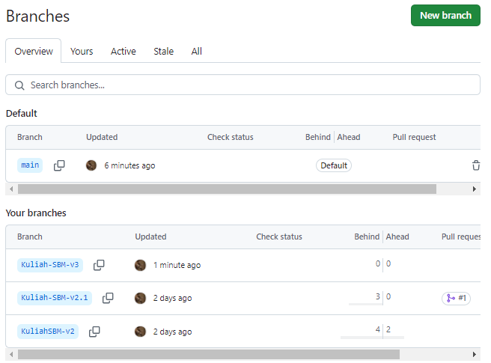
Branches
Branch
Click New branch button for a new branch
Main document
Branch 3:
Kuliah-SBM-v3
Choose Branches X for updating
Branch 2:
Kuliah-SBM-v2.1
Branch 1:
Kuliah-SBM-v2

Slide 28
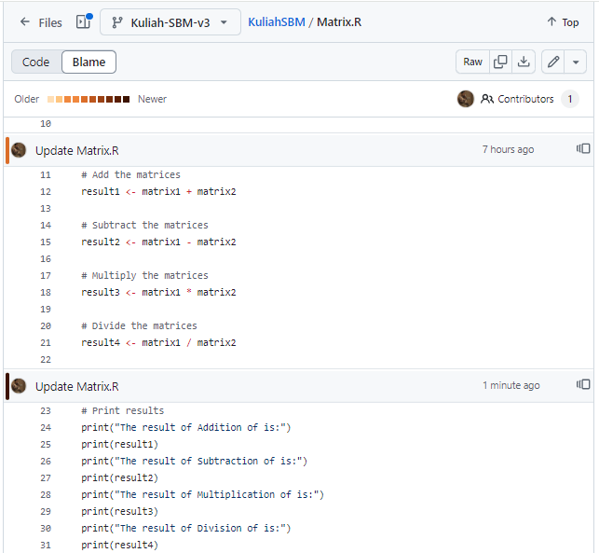
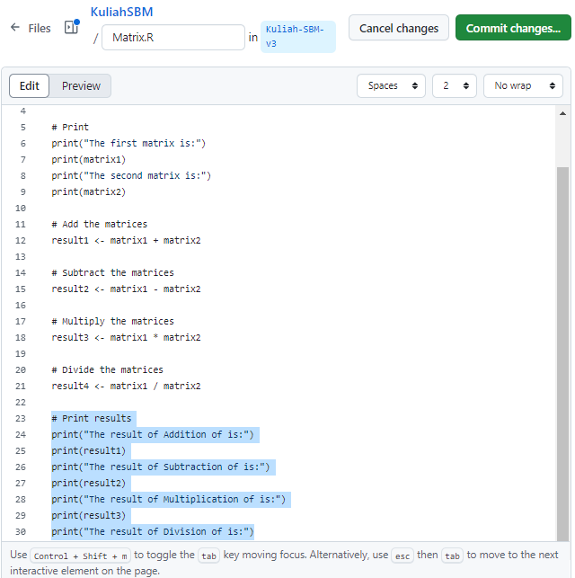
Updating Branch
Branch
Updating branch code:
#Berikut merupakan revisi kode
Historical updating branch code

Slide 29
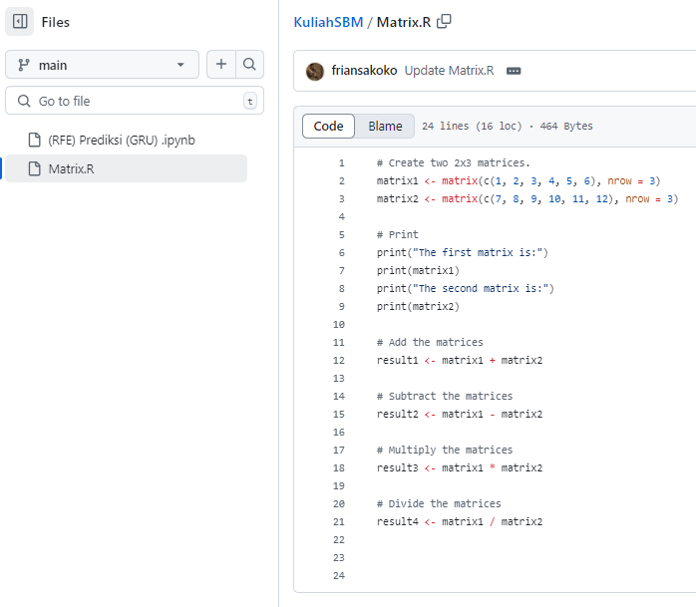
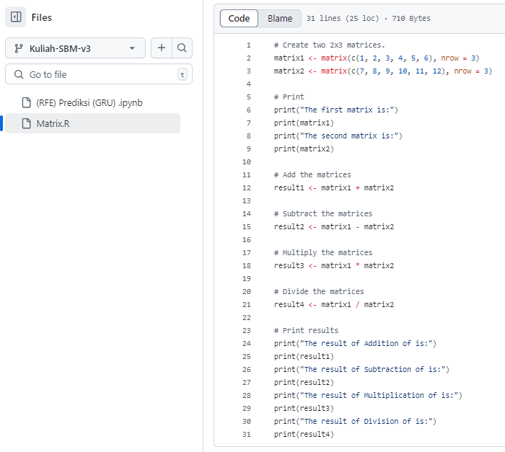
Main and branch difference
Branch
main document
branch document
Code updates on Branch do not affect the main document

Slide 30
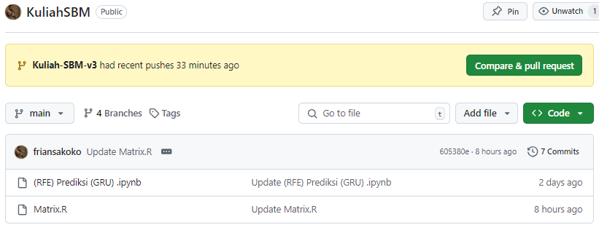
Merge (Method 1)
Merge
Choose Branch for Merge the branch into main document
Click the Compare & pull request button for merge the document
Branch:
Kuliah-SBM-v3

Slide 31
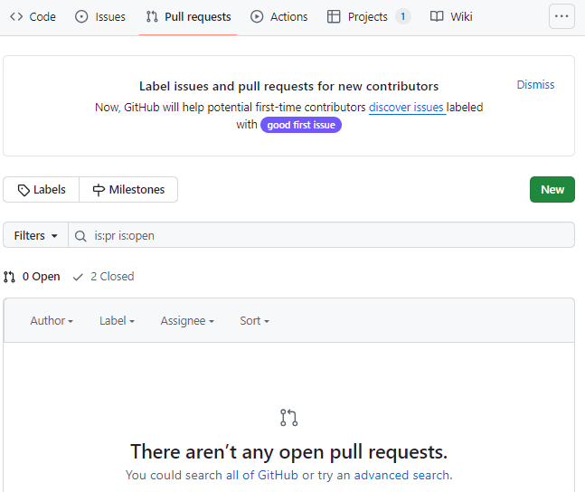
Merge (Method 2)
Merge
Click the Pull request

Slide 32
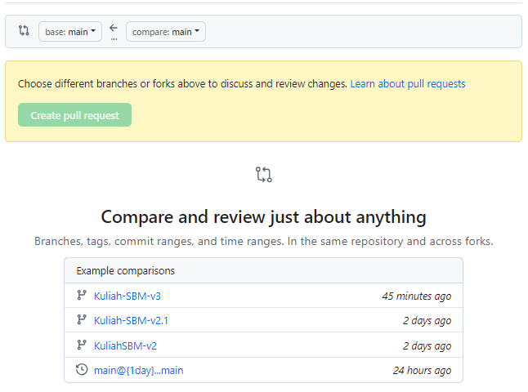
Merge (Method 2)
Merge
Select the document you want to merge

Slide 33
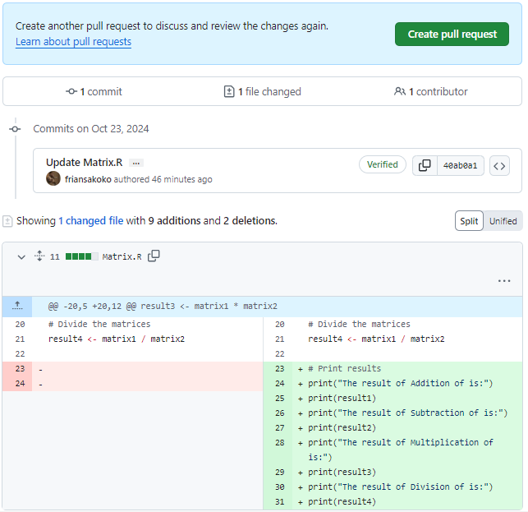
Merge
Click the Create pull request button for merge the document
Check the code,
The red background will be removed
The blue background will be inserted

Slide 34
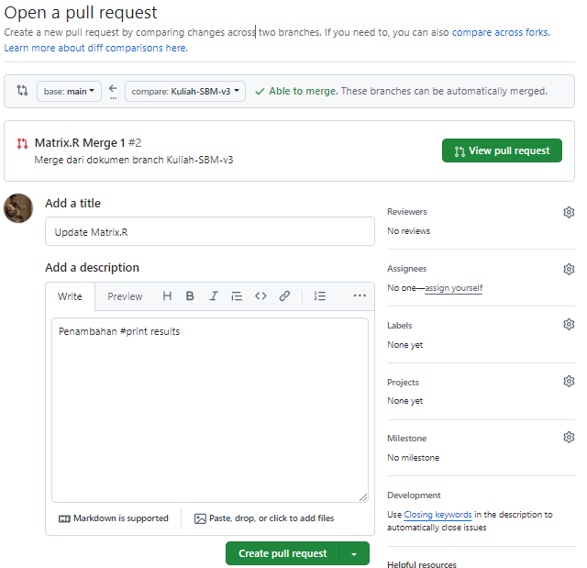
Merge
write the reasons for doing a Merge
Click the Create pull request button for merge the document

Slide 35
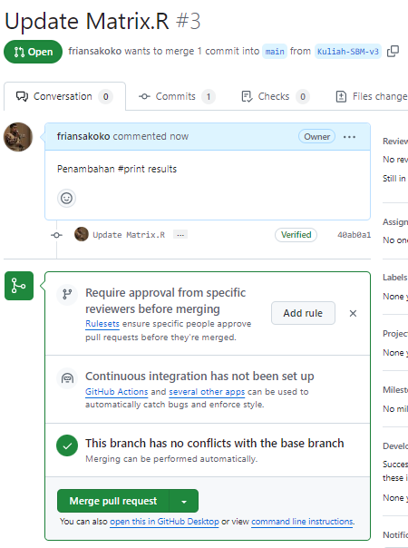
Merge Process
Merge
No conflict code when Merge the document
Click the Merge pull request button

Slide 36
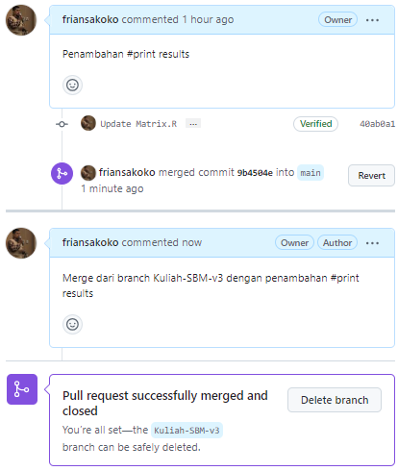
Congratulation!
Merge
The merge activity is complete

Slide 37
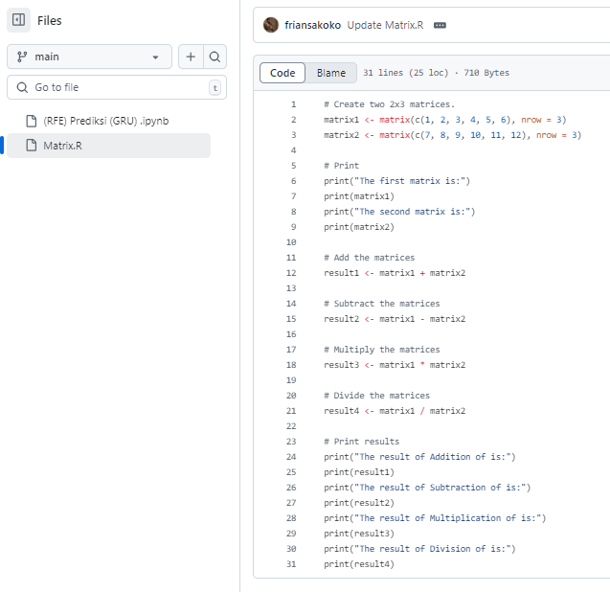
Comparing the code
Merge
Before Merge
After Merge

Slide 38
Develop someone else’s project

Slide 39
Develop someone else’s project
Forking
Update the Forking Data
Load a Dataset
Create a File

Slide 40
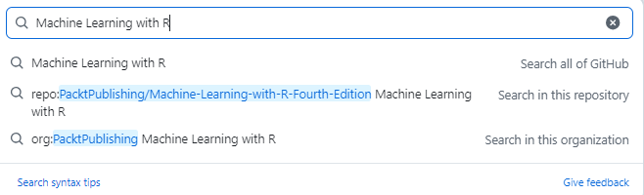
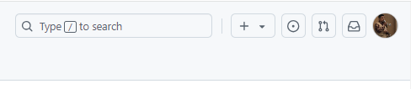
Search someone else’s project
Forking
Type your keyword
Click the search box in the right corner

Slide 41
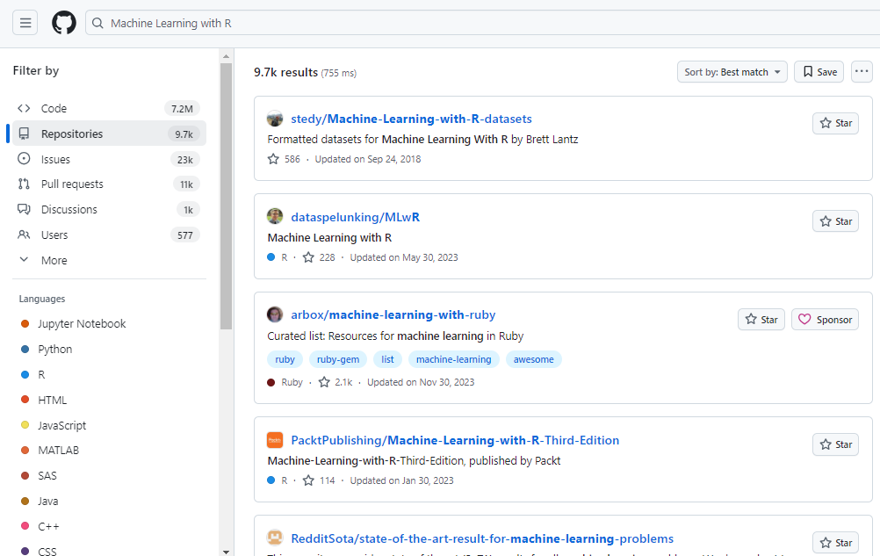
Choose the someone else’s project
Forking
Filter based on type of the project
The someone else’s project based on ‘Machine Learning with R ’ keyword

Slide 42
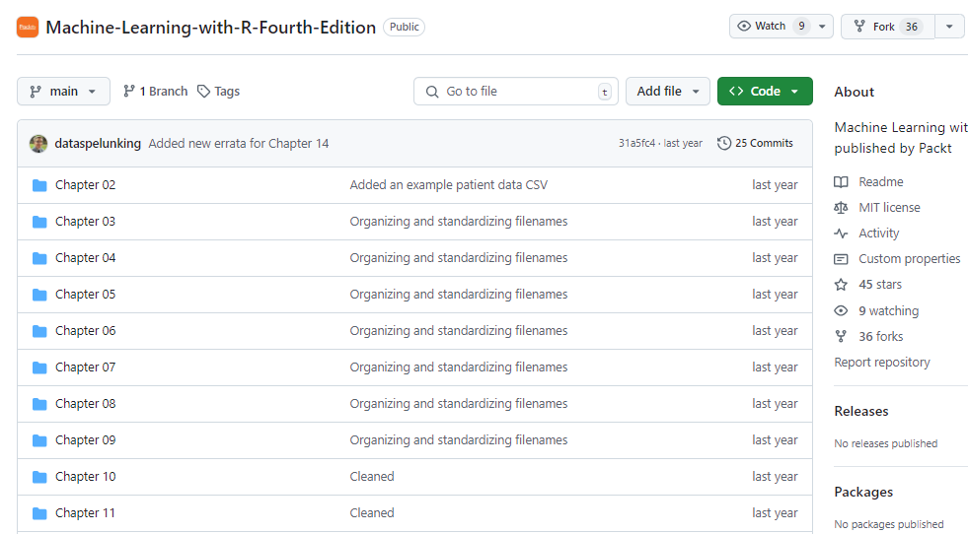
Forking
Forking
Click Fork button to copy someone else’s project

Slide 43
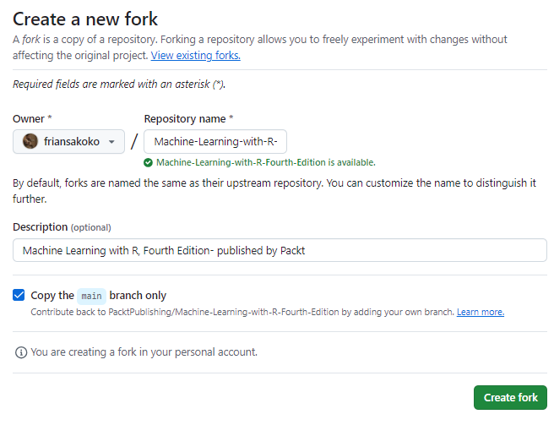
Forking process
Forking
Write the repository name
Read the rule
Click Create fork button

Slide 44
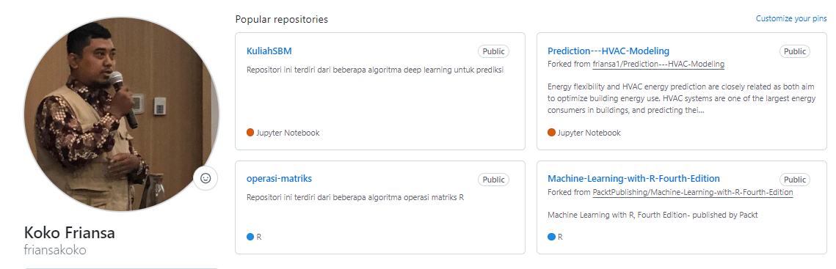
Congratulation
Forking
Someone else’s project has been copied and is now in your repository

Slide 45
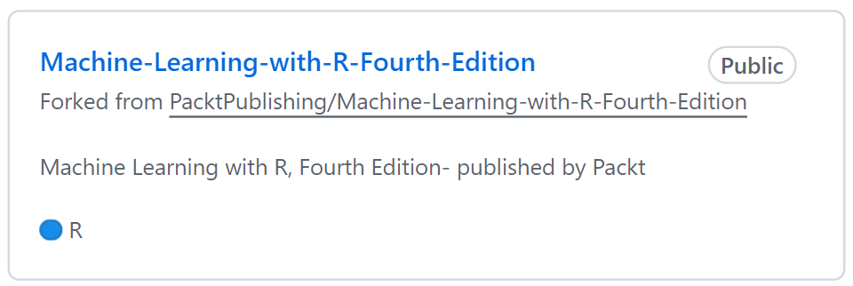
Exercise
From your forking repository
Do: branch and Merge

Slide 46
Find a dataset
Update the Forking Data
Click Chapter 02
(Have a data CSV in description)

Slide 47
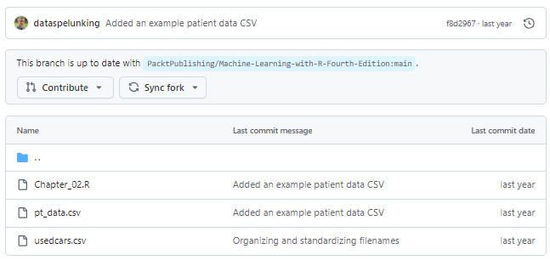
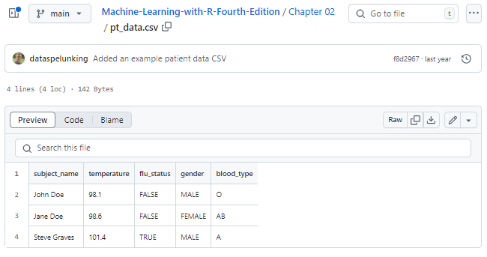
Choose a dataset
Update the Forking Data
You can edit the dataset, click
pt_data.csv preview
Choose pt_data.csv

Slide 48
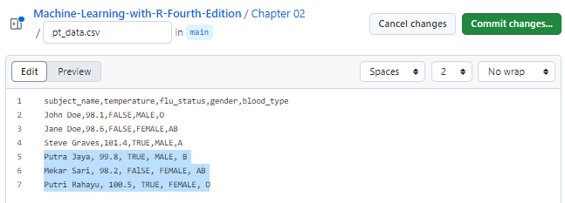
Editing process
Update the Forking Data
pt_data.csv dataset before editing
Update the dataset

Slide 49
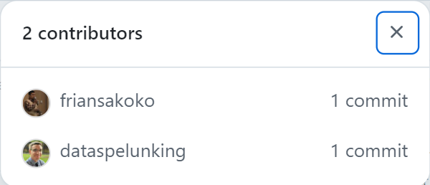
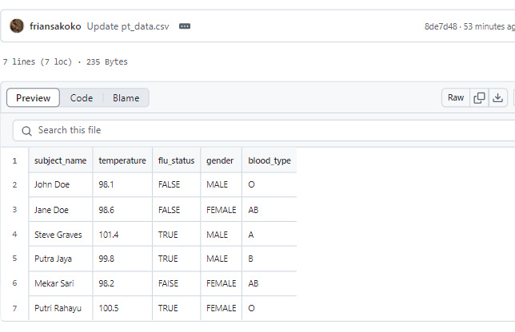
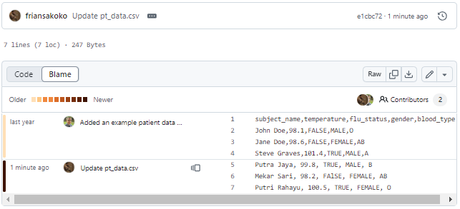
Update the Forking Data
Congratulation!
From this forking project, you can see the all contributors
The updated dataset is complete
Update the dataset

Slide 50
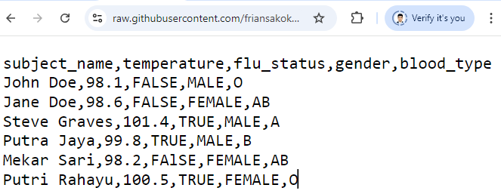
Load a dataset
Load a Dataset
GitHub can’t execute code or script, so we can load the dataset using the url link
Click Raw button
Then, copy the link in url box
https://raw.githubusercontent.com/friansakoko/Machine-Learning-with-R-Fourth-Edition/refs/heads/main/Chapter%2002/pt_data.csv
url link:

Slide 51
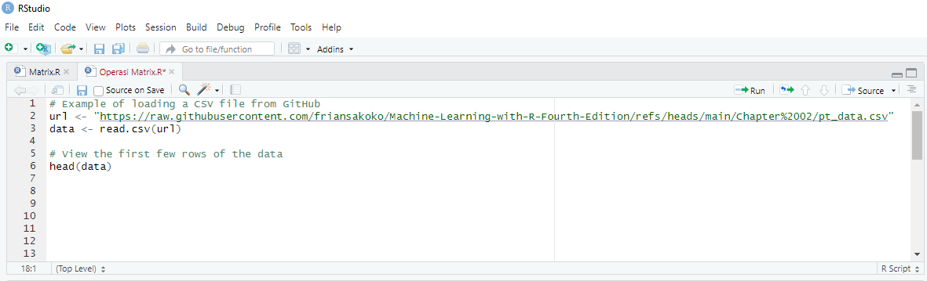
Load a dataset in RStudio
Load a Dataset
Open Rstudio, and write the R script
Click Run to execute the script
Paste the url link in RStudio
# Example of loading a CSV file from GitHub
url <- https://raw.githubusercontent.com/friansakoko/Machine-Learning-with-R-Fourth-Edition/refs/heads/main/Chapter%2002/pt_data.csv
data <- read.csv(url)
# View the first few rows of the data
head(data)
the R script to load and view a dataset

Slide 52
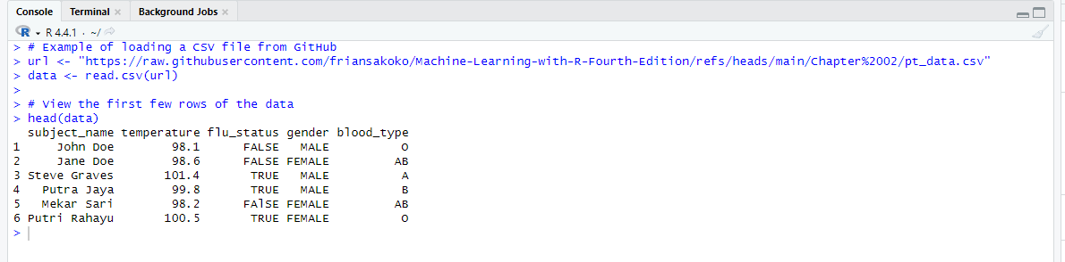
Congratulation!
Load a Dataset
you can load the dataset

Slide 53


Create a File
Create a File
In addition to uploading a file, you can create files or write script code directly on GitHub.
The basic R script code
Make sure the script code works in Rstudio

Slide 54


Write a code
Create a File
From the folder in right corner, click Create new file
Write the R script

Slide 55

Congratulation
Create a File
A new Rscript file has been created
A new Rscript

